Slide 1

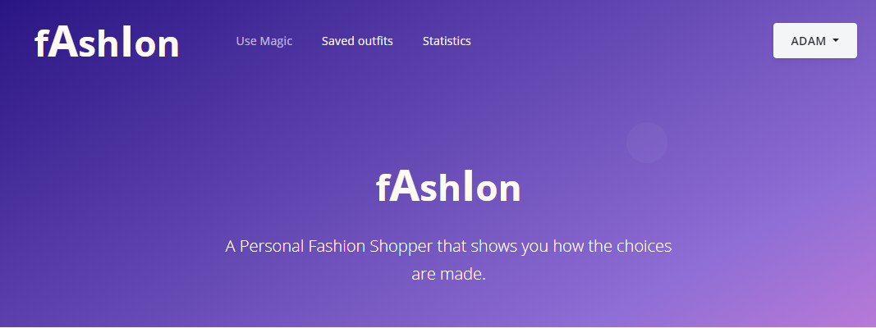
fAshIon
A Personal Shopper
Donald Lau
Notes:
Good afternoon everybody, today I will be presenting our project fAshIon, a personal shopper that gives you explainable recommendations.

Slide 2
Motivation
Repetitiveness
Blackbox
Notes:
I will start by addressing the motivation of this project, showing the existing problems of recommender systems
Recommender systems are surrounding us, especially when we are online shopping on amazon, asos and so on.
A common issue is repetitiveness in recommendations.

Slide 3
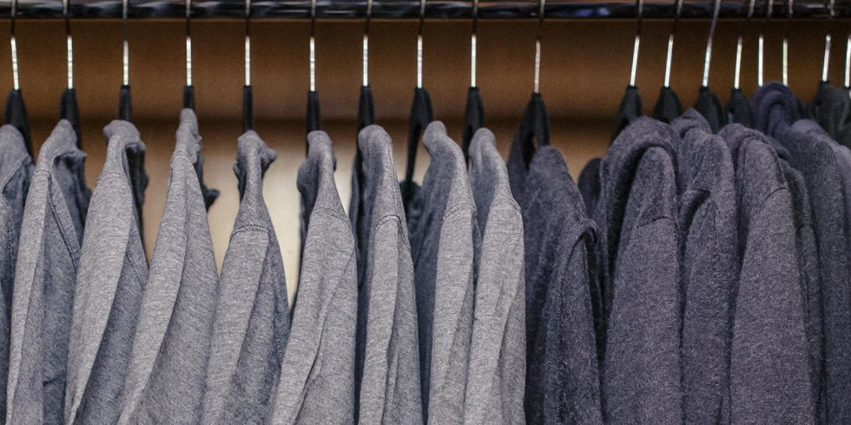
Motivation
Repetitiveness
Blackbox
Notes:
From personal experiences, I have been recommended the same item that I just bought but in different color or slightest variation.
Obviously these recommendations aren’t really useful, as I don’t need to buy the same item again.
This happens because these recommenders rely heavily on similarity between items to make recommendations
when there’s more aspects that should be taken into consideration.

Slide 4

Motivation
Repetitiveness
Blackbox
Notes:
Moving on to the second issue, recommenders usually lacks explanations.
Even when they try to justify, they tend to only say what item causes the suggestion
such as we recommend you this pink tshirt because of the red tshirt you bought before.
We cannot know why it is pink
is it because of the color red in the last tshirt or do they think pink goes well with this tshirt.
Obviously, we also have no way to giving feedbacks to the untold reasonings to improve future predictions.

Slide 5
Our Solution
Notes:
(0-2m)
Because of this, we decided to explore on the topic of explainable recommendations
using ontology framework to integrate compatibility and context semantics along with similarity
Now I am going to run a demo video of our model to visualize what we have achieved in this project

Slide 6
DEMO
Notes:
(2m-6m)
This is the graphical user interface of our model, there are three main webview, the most interesting bit happens in this prediction view
Users can input arbitrary fashion items here in the input section
Let’s stick to a simple case and say we got a teal skirt, this look alright
Then we input our second item, a gold necklace, this doesn't look like our necklace so we will click through the image
to try and find a closer match and done, lets see what click generate outfit and see what items we would get
Our model expects these inputs to be a partial outfit and it will output potential fashion items to complete the outfit
Seems like we get some good recommendations and some not so good recommendation
But then we can see that there are explanations to each recommendations and we can give feedback to each of them
Now lets go and see if existing user will get a different results
We can see that the result is mostly in black and white
We also see that most items are in black or white and cotton and silk are common material due to the user preferences
Beverly thinks this explanation is good and decide to give a positive feedback
Then she also pick a few items to form an outfit
If we go to past selection page , we can see the new preference is updated and also the outfit is stored

Slide 7
Outline
The Problems
Model vs Problems
Data
Design
Evaluation
Next Steps
Notes:
Now that wraps up the demo, we will continue our presentation with the following topics.
I will now give a bit more insight on the problems we mentioned

Slide 8
Problem 1
Repetitiveness
Collaborative filtering
Content-based filtering
Hybrid
Similarity semantic
Notes:
There are 3 common types of approaches in recommender systems:
“collaborative filtering": it determines recommendations based on the preferences of other users with similar profile
"content-based filtering": it recommends items close to the user’s usual taste and past selections
"Hybrid": it combines both filters
The shared trait of these approaches is:
primarily focus on the notion of similarity and pay less attention to the semantics or compatibility
Meaning, they look for items that are interchangeable without impacting the overall feel
Rather items that go well together in a whole outfit,

Slide 9
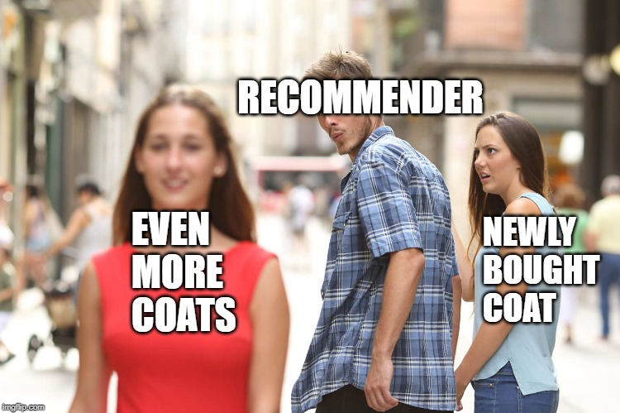
Problem 1
Repetitiveness
Notes:
(6m-8m)
The focus on similarity is why this would happen
To better understand what we means by semantic, consider this scenario:
Consider a user Bob who is picking an formal outfit
Bob uses a suit as input, the recommender output a pair of brogue shoe
This is because Bob or users like Bob recognized the two items fit together in a formal context
Recommender itself does not understand these items as having a formal semantic
Without the knowledge of this semantic, recommenders still works in occasions, such as for Bob, but this is not always the case:
A user who has a more niche taste than the general public may find the recommender performing poorly
It is also challenging for recommenders to adapt to new fashion trends that most users are not yet aware of

Slide 10
Problem 2
Lack of explanations
Notes:
(8m-8m30s)
For second problem, lacking explanations is concerning because as the slide shows, it leaves the audiences blank and confuse:
It hinders the improvement on the recommendation performance,
Users cannot spot imperfections in the untold reasoning
therefore they also have no way in giving feedback to improve the system
In similar way, this slows the process of learning user’s preferences to give a tailored experience

Slide 11
Our Model vs The Problems
Ontology framework
Similarity, compatibility, context semantics
Explanations & feedback
Repetitiveness
Focus on similarity placeholder
Lack of explanations
Notes:
(8m30s-9m30s)
So how does our model fits into all this:
our model fAshIon is specialized in auto-completing outfit, using semantics of fashion items and user preferences
The semantics are based on various topic models built on top of our handcrafted ontology framework
An ontology framework encodes the visual-semantic
For example, an ontology framework can break down a shirt into 3 levels
first it identifies shirt is a top item
then more refined details like volume, color and closing (such as button or zipped)
And finally on a more abstract concept level, like the cutting or the context of usage, whether for work or sport
With these additional semantics we attempt to avoid repetitive results
To address the lack of explanations, we go beyond simply providing explanations, we also enable a feedback system for users to interact with the explanations

Slide 12
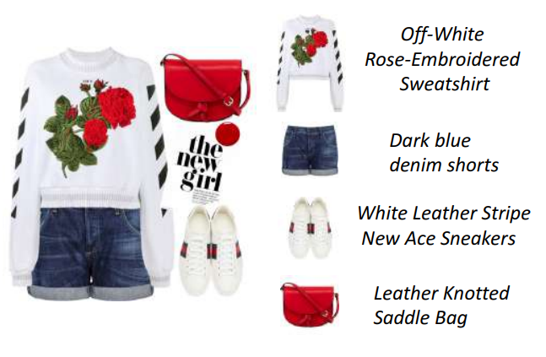
Data
14000+ fashion sets
100000+ unique items
Vocabulary of 2400+ words
Notes:
(9m30s-10m10s)
Now I will depict an end-to-end journey from how our system is initialized all the way to user interaction to give a thorough understanding of our model
First we take a look at the data that’s used in training the model:
We use a dataset from a related research that’s original crawled from polyvore
After some basic clean up we remain with over 14k fashion set and over 100k unique items as our raw training data
Both fashion set and items have a pairing description
The data is then pre-processed with some natural language processing techniques like lemmatization and stop words removal

Slide 13
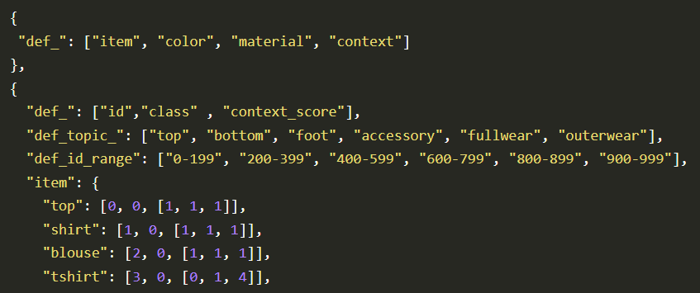
Ontology framework
→
Tshirt: [0, 1, 4] → [0%, 20%, 80%] (formal, semi-formal, casual)
Notes:
(10m10s-11m20s)
We extract a subset of frequent words to derive our ontology framework
Three ontology classes are implemented as item, color and material,
we also define three contexts which are formal, semi-formal and casual
Item class has sub-classes top, bottom, footwear and more to represent the common parts within an outfit
Both items and materials are associated with a context score, which show their likelihood of fitting in different context,
tshirt has the context score [0, 1, 4] in our framework, which read as the likelihood of 20% in a semi-formal occasion and 80% casual context
Color class doesn’t have context likelihood but it has root color attribute
to group more refined color variation together
Like gold to yellow and brown and orange has root colors to red and yellow

Slide 14
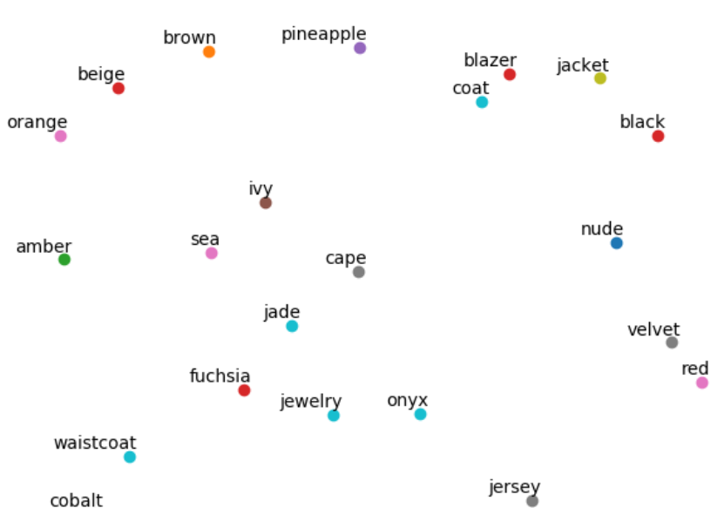
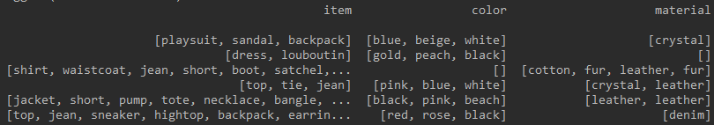
Word Embeddings
Learning semantics of ontological features
Notes:
(11m20s-12m30s)
Using our ontology framework, we extract the ontology keywords for every fashion item in the data
Then we phrase different combinations of skip-grams model, such as within items-to-items or cross space color-to-material
The skip-grams are fed into tensorflow neural network to get the corresponding topic models
Our loss function is noise-contrastive estimation training loss
We also employ a gradient descent optimizer, mini-batch training and negative sampling to enhance the training performances
For simplicity we chose a common word embedding dimension of 128 as our output
we use the cosine similarity between the word embedding vectors to representing their similarity and compatibility
I will be abbreviating this similarity-compatibility value as the sim-comp value for the rest of the presentation

Slide 15
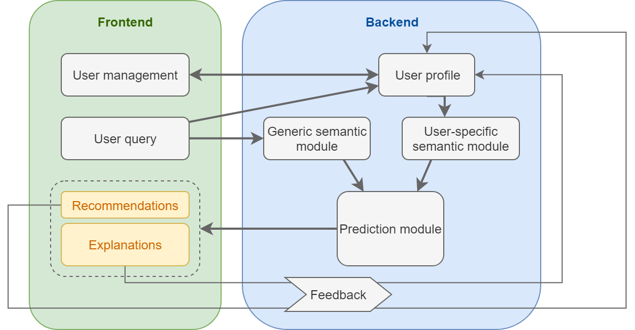
Data Flow
Notes:
Since we now obtain both sim-comp values and context semantics, we can proceed with the generic prediction:
Assume a new user for a minute, we can ignore user preferences
the user query will be picked up by the generic semantic module and output two things
First the sim-comp values between the input words and the all ontology keywords in the framework
Secondly the context likelihood of the inputs
The prediction module makes use of these and return items with the highest sim-comp values in the right context

Slide 16
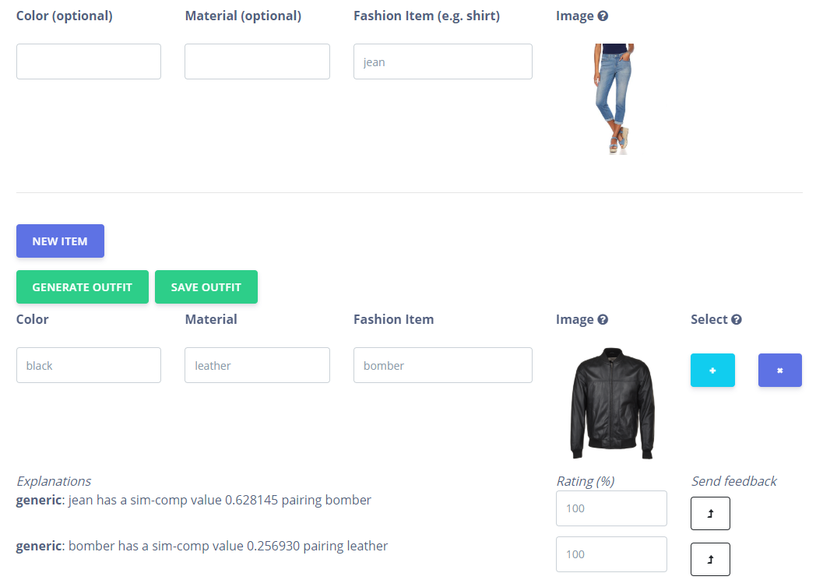
Notes:
To visualize with an example, the single input item jean would be match with a bomber jacket
This is because the jean has a high sim-comp value with bomber jacket, this is our generic explanation
A context likelihood is also taken into account, our system recognizes both jeans and bomber jacket are towards casual context
On a side note, images in our model are from an instance of google search engine
So we are working with external data as well

Slide 17
Explanation Types
For features > 3 times
Modifier = min( , 0.5)
Overall context likelihood > 0.5
Modifier = 0.35
#feature
#outfit
Generic
Passive preference
Active preference
Notes:
(1min10sec, 14m40s)
There are two more types of explanation in our model, passive and active user preferences
Passive preferences are obtained from the user’s save outfits, for any features occurring more than 3 times in total
Meaning, we get a passive preference on color black
if we have 4 black items in the same outfit or in 4 different outfits
the calculation for the value is shown here
Same formula is used for items and material
context likelihood is a bit different, a constant modifier of 0.35 is used instead
Both generic explanation and passive preference can be turned into active preference
when users give their rating on the explanation, it becomes an active preference
The rating is attached to the feature and will be used in future predictions

Slide 18
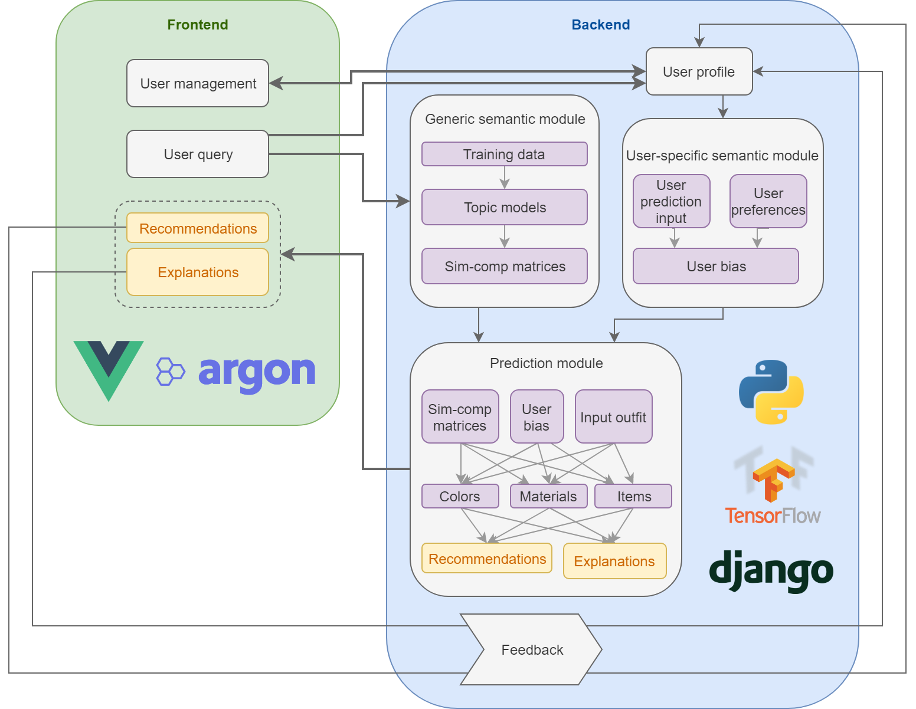
System
Architecture
Notes:
At this point, we have actually talked about most of the high level intuition of our model
A quick recap:
we know about sim-comp values and context semantics generic module
passive and active preferences for user module
Their output will be fed to the prediction module
I am now going to use an example to explain the technical details of our prediction algorithm
some values in this example are changed in order to illustrate the steps clearer

Slide 19
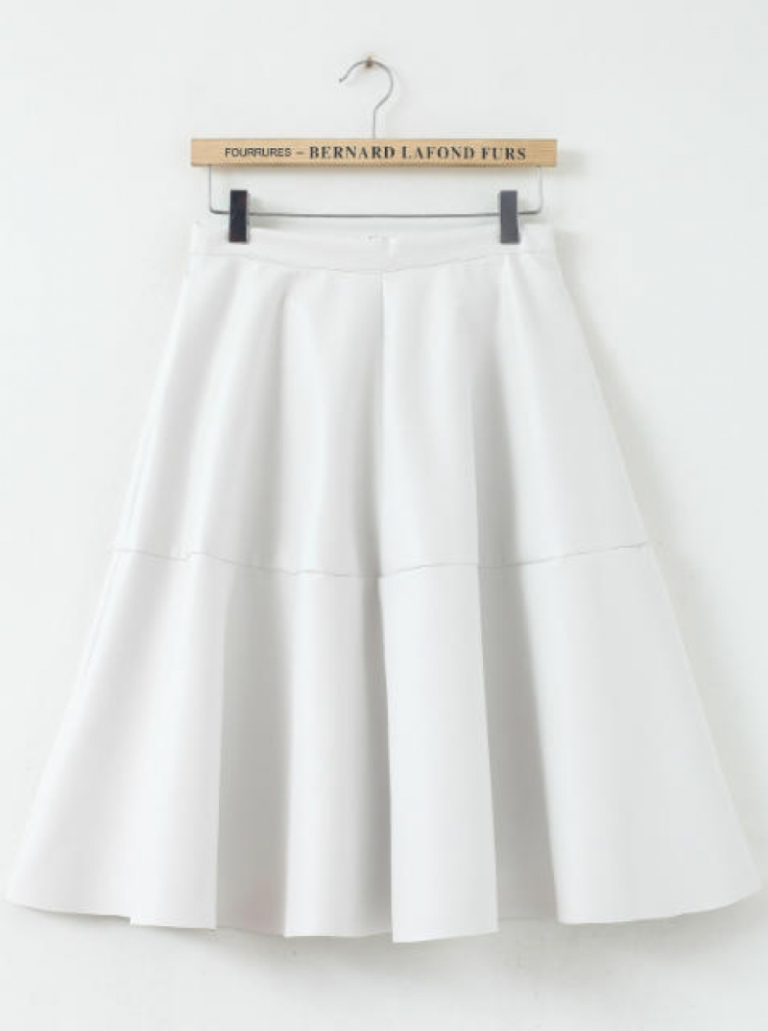
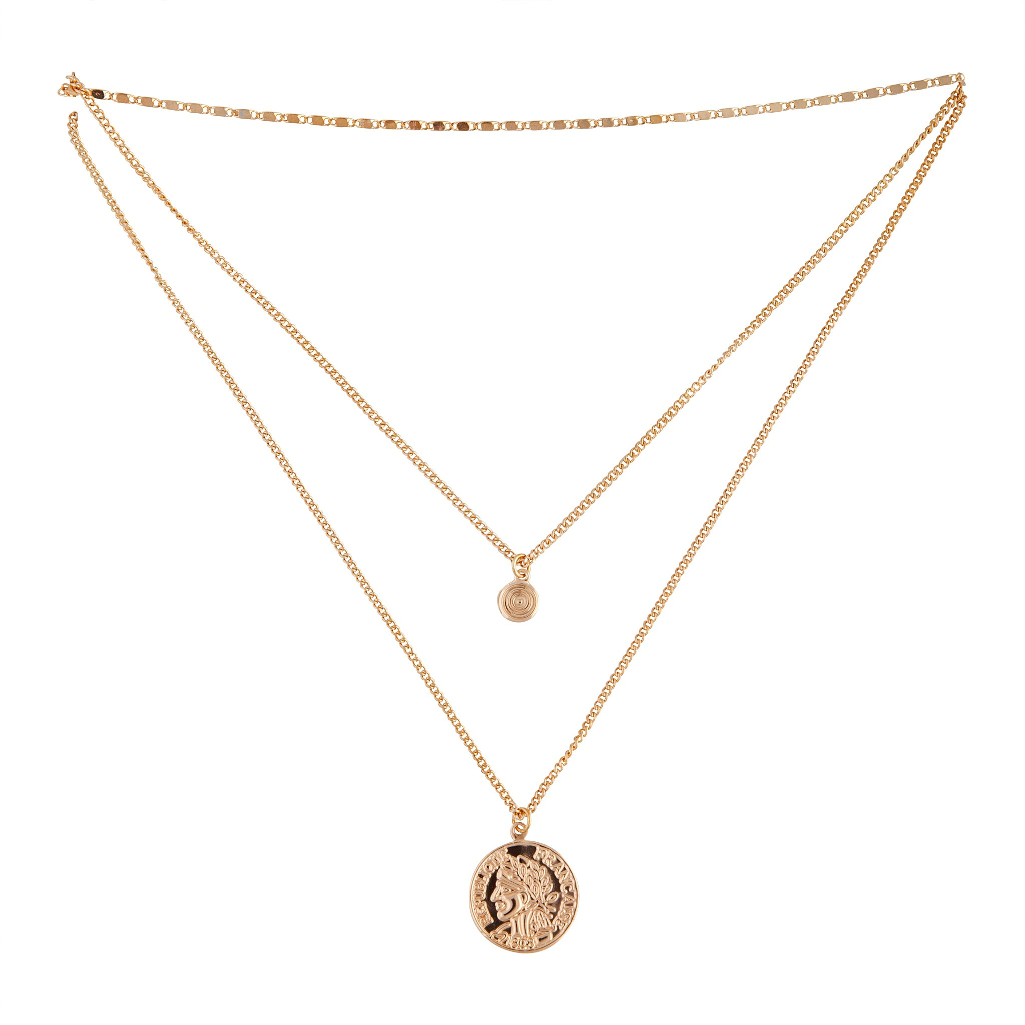
User query and preferences
Passive: formal context, i.e. modifier of 0.35
passive : heels +0.2
Active: 200% in skirt-heels
Active: 0% blue
White skirt
Necklace
Notes:
(10sec, 15m20s)
Consider a user Amy who input white skirt and necklace in the user query and has these four user preferences

Slide 20
Getting outfit context
Passive: formal context, i.e. modifier of 0.35
passive : heels +0.2
Active: 200% in skirt-heels
Active: 0% blue
White skirt
[1, 1, 0]
Necklace
[1, 1, 1]
[0.4, 0.4, 0.2]
[0.35, 0, 0]
[0.55, 0.30, 0.15]
Notes:
(40sec, 16m)
We first obtain the context likelihood from the inputs and user preferences
This determines what context Amy is looking for, is she finding a formal outfit or casual one
we see that skirt has context tends toward formal and semi-formal while necklace has a uniform likelihood
After aggregation and normalizing to 1, we get the value showing a higher likelihood of it being a formal/semi-formal outfit
Then we add in the user preference and normalize again
We ends up with a probability of over 50% of it being formal outfit

Slide 21
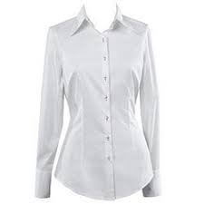
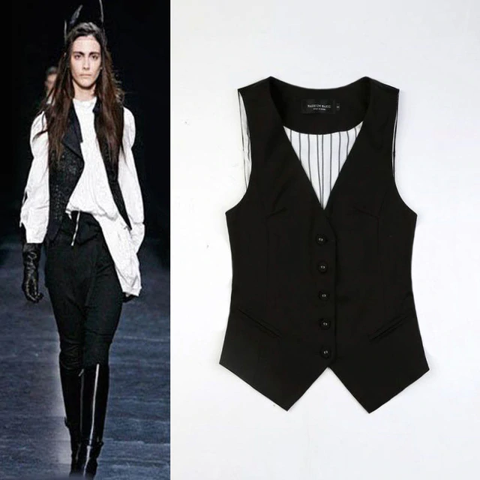
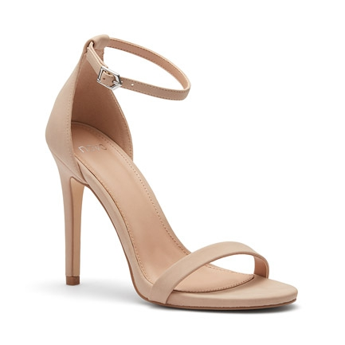
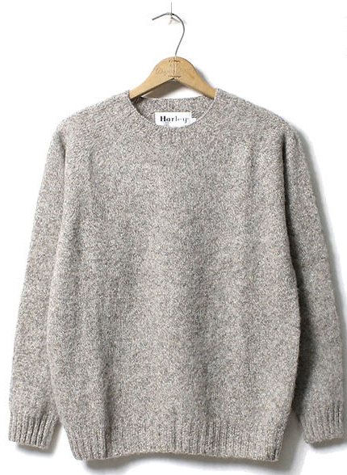
Getting sim-comp values between inputs and items
. . .
. . .
White skirt
0.3
0.35
0.2
0.25
. . .
Necklace
0.2
0.1
Notes:
After identifying the outfit context, we now proceeds to find sim-comp values for items
We iterate through the input items skirt and necklace
for each of them we obtain a corresponding list of items with their sim-comp values
So for skirt the similarity/compatibility with blouse is 0.3
This list includes all item in our framework, as everyone of them is a potential recommendation

Slide 22
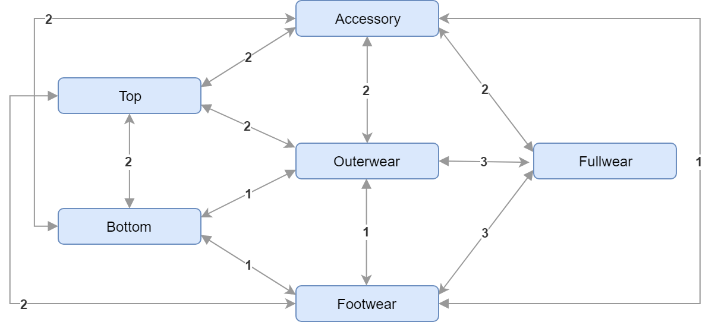
Applying influence modifiers
. . .
. . .
White skirt
0.3
0.6
0.35
0.7
0.2
0.25
Notes:
(40sec, 17m10s)
Then these sim-comp value are modified by the influence modifier
The influence modifier value is based on the item types, for example skirt is a bottom item, so when going through the top items like shirt and vest, the values are multiplied by 2
The reasoning behind this influence modifier is that different pairs of item types should have more different impacts
As in you probably pick a sweater matching with your blouse more than matching with your earring
This also helps to combat against the improper triangle problem

Slide 23
Applying user preferences
. . .
White skirt
0.6
0.7
0.2
0.4
0.6
0.25
Passive: formal context, i.e. modifier of 0.35
passive : heels +0.2
Active: 200% in skirt-heels
Active: 0% blue
Notes:
(40sec, 17m50s)
The next thing we do is the apply the user preference, first we apply the active preference
we go through all the pairs, locate the pair of skirt and heels and double the value because of the 200%
Following this we add the 0.2 passive modifiers to heels as well, this is applied to any pairs with heels as one of the members
So both skirt-heels and necklace-heels pair will receive the passive modifier

Slide 24
Calculating final sim-comp values
0.6 * [0.33, 0.33, 0.33] ^{T} [0.55, 0.30, 0.15] = 0.198
0.5 * [0.33, 0.33, 0.33] ^{T} [0.55, 0.30, 0.15] = 0.165
Final sim-comp value (FSCV)
FSCV_{item} = ∑_{inputs, items} FSCV_{input, item}
FSCV_{input, item} = SCV * [context_{item}] ^{T} [context_{outfit}]
Notes:
(1min, 18m50s)
The last calculation is to obtain the final sim-comp value
This is obtained by using the dot product of the item context likelihood and the outfit context likelihood
The dot product reflects how well the item is fit into the targeted context
in this example we want items that lean towards formal context
To find the final value for heels, we multiply each pairing sim-comp value with the dot product
And summing all these values together
We repeat this for all items in our framework

Slide 25
Quick recap
Outfit context likelihood
Sim-comp value for all item-pairs
Apply modifiers to pairs
Get FSCV for all items
Notes:
(30sec, 19m20s)
That is quite a lengthy calculation, I hope I didn’t lose anybody there, a quick recap of what we have done is
We get the outfit context likelihood
Then the basic sim-comp values for all items pairing with the inputs
Next we apply different modifiers to all pairs
Using these pairs and the outfit context to calculate the final sim-comp value

Slide 26
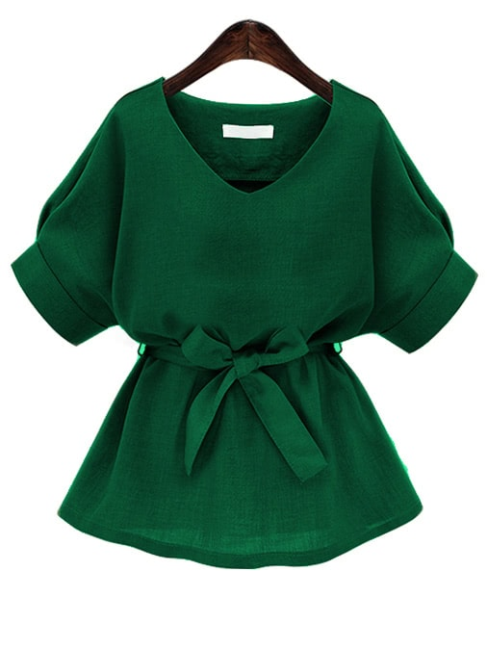
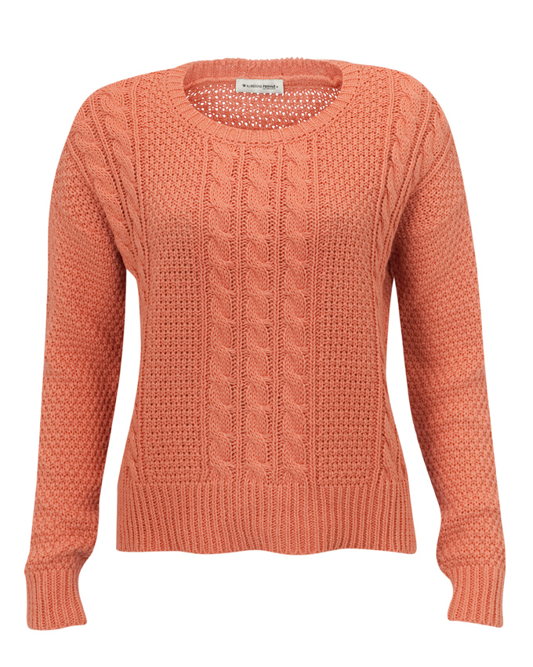
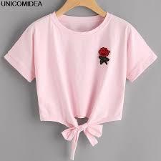
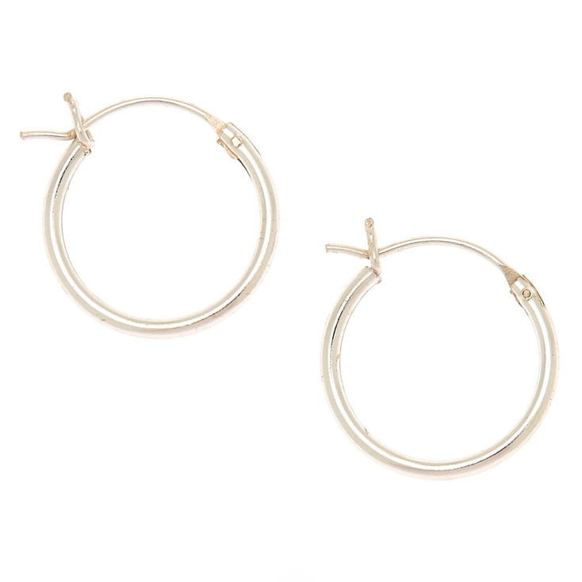
Finalizing recommendations
Top: | Bottom: | Fullwear: | Footwear: | Outerwear: | Accessory:
2
1
5
3
4
Notes:
With the final values we can start deciding what items to recommend
The choosing process is quite straightforward, we sort the items in descending order with final sim-comp value and choose the top 10 items under 3 constraints

Slide 27
1st constraint: no repeating type with input
Top: | Bottom: | Fullwear: | Footwear: | Outerwear: | Accessory:
2
1
5
3
4
Notes:
Firstly, for items having the same types with input they won't be chosen
so we won’t recommend bottom when she already picked a skirt
This doesn’t affect accessory however, since it’s normal to have multiple accessory like necklace and earrings

Slide 28
2nd constraint: no repeating type with input
Top: | Bottom: | Fullwear: | Footwear: | Outerwear: | Accessory:
2
1
5
3
4
Notes:
Second constraint is that if the user has chosen a full wear, then both top and bottom items won’t be recommended
This holds the other way round as well
Because we believe it doesn’t make sense if the user chooses a dress and got recommend a pair of jeans
The user can overrule this by choosing both top and fullwear or both bottom and fullwear,
Then we trust the user being smarter and know what they are doing and remove this constraint

Slide 29
3rd constraint: no bias towards particular item type
Top: | Bottom: | Fullwear: | Footwear: | Outerwear: | Accessory:
2
1
5
3
4
Notes:
The last constraint is that at anytime the recommendations of a certain item type cannot has more than 3 items than the types with least count
Meaning if we keep recommending accessories and none in top, footwear or outerwear
when we want to recommend a 4th accessory we have to stop and recommend something these 3 classes

Slide 30
Material prediction
Leather | Denim | ... | Cashmere | ...
Leather | Denim | ... | Cashmere | ...
Leather | Denim | ... | Cashmere | ...
Notes:
Material prediction is done in similar fashion, for each item we get the sim-comp values for every pairing material
Apply the modifiers and context likelihood dot product
And pick the material with the highest final sim-comp value

Slide 31



Color prediction
White | Black | Grey | Pink | Red | Yellow | Green | Blue | Purple | Brown
 |  |  |  |  |  | + | +
 |  |  |  |  | + |  |  |  | +
+ | + | +
Teal
Gold
Silver
Notes:
(50sec, 22m10s)
For color there’s slight variation
Instead of context likelihood we have root color likelihood
because color doesn’t have context score but only root color attribute
From inputs and user preferences we get the root color scheme, which is like a root color likelihood
Then for each recommendation, we use the item and material to get nearby colors,
their sim-comp values are then multiply with the corresponding root color likelihood
For the color silver, we will multiply the sim-comp value with the likelihood of white, black and grey
So if the root color scheme has low likelihood on black and white, then silver will get a lower sim-comp value
First we get a root color scheme from user inputs and user preferences, which is similar to the outfit context likelihood, but instead there’s 10 root colors in total
In this example recall white is the only color input
we get nearby colors to white and aggregate and normalize them like how we did for outfit context
The result would be white having a higher likelihood

Slide 32
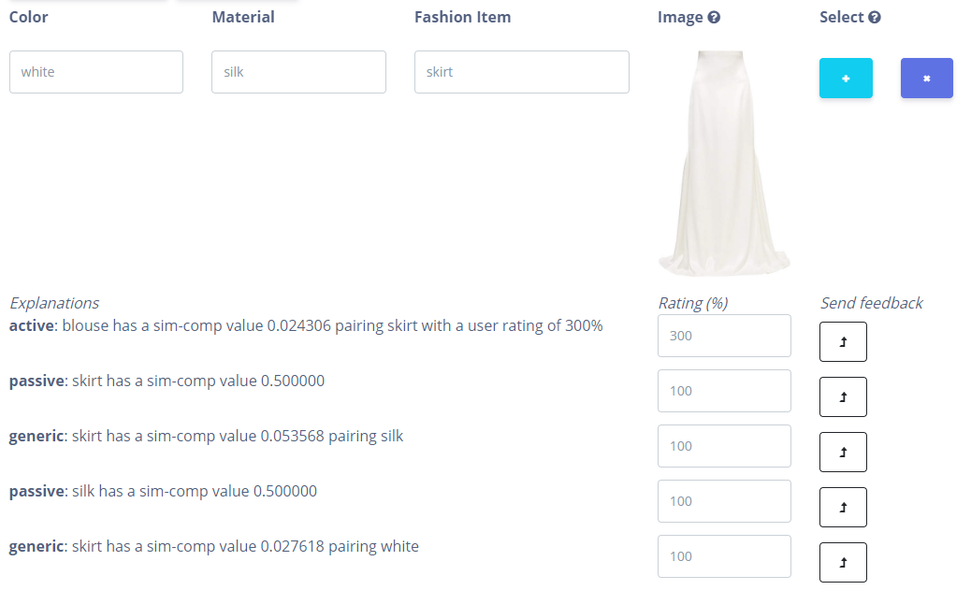
Notes:
(10sec, 22m20s)
In the frontend this is how a recommendation would look like
as we can see there’s different type of explanations for the recommendation

Slide 33
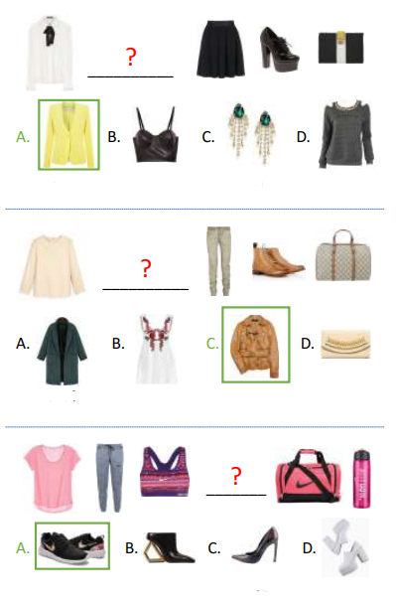
Evaluation
Fill-in-the-blank tests
User surveys
Notes:
(30sec, 22m50s)
Moving on, I would like to give a brief outline on how we evaluate our model
We use the fill in the blank tests that’s inspired by the training dataset
In the original testset, each question comes from an actual outfit
one item within the outfit is taken out and the model is expected to find it among some other randomly chosen items
We made slight modification to the tests, so instead of finding the correct item we wish to find the correct ontology keywords
We also make our own questions from sample users we obtain via user survey, so we can evaluate the user preferences too

Slide 34
No user preference Both user preferences | Top 3 recommendations | Top 5 recommendations | Top 10 recommendations
100% correct keywords | 31.2% 36.2% | 33.5% 39.1% | 36.3% 44.6%
50%+ correct keywords | 33.4% 42.4% | 35.0% 46.6% | 38.6% 57.7%
33%+ correct keywords | 37.7% 55.8% | 40.5% 62.2% | 45.8% 73.6%
Notes:
(40sec, 23m30s)
We have evaluate our model under different conditions, including default users with no preferences at all, only passive preferences and both preferences
These percentages of correctness indicate at least how many keywords need to be recommended
In our sample users, most items have both colors and material associated, so 100% tends to be 3 out of 3, 50% for 2 out of 3 and 33% for 1 out of 3
From no preferences to both preferences, we get a noticeable increase in accuracy in most categories

Slide 35
Survey results
"Good to see why a clutch is chosen over a purse"
"If only ASOS has this then I can see why I am getting ridiculous results"
"Oh, it learns faster than I expected"
“Is it possible to separate similarity and compatibility?”
“Can I not add my own preference from scratch?”
Notes:
(30sec, 24m)
other than quantitative analysis, we also have quality analysis to reflect on the usefulness of explanation
The majority of the feedback in our survey are positive, recognizing the impact of explanations
Two areas of critics are confusion caused by mixing similarity and compatibility, and also request to add rules without going through the feedback procedure
We have considered the separating similarity and compatibility, but due to time constraint and we would like to explore more on the context semantics we decided to keep it combined
For the functionality of adding preference directly, it’s straightforward as just to expose an internal api, we could easily add it in if we want to deploy to production

Slide 36
Next Steps
Better ontology framework
More explanations
Unseen words
Imaging techniques
Notes:
(50sec, 24m50s)
While we regard our model has successfully tackle the repetitiveness and blackbox problems
Also demonstrating how explainability is useful and can improve recommendation quality
There are several directions that this project could be taken further
Most obvious one is to improve on the ontology framework, right now we only have 3 classes but there are more subtle semantics that can be included
Such as variation within same item
This can lead to a greater degree of explanation
Supporting unseen word is another way to go if we want to scale our project
at the moment we didn’t implement that because the associated semantics is challenging to be accurately generated
It would also be interesting to use imaging techniques to extract features so users only need to pick and item and the color and material will be automatically chosen
Or even using only image as input
This wraps up my presentation, so thank you all for listening and I believe now would be the Q&A session

Slide 37
Thanks!

